Slide 1
The Commons
Qeii Library main floor.

Slide 2
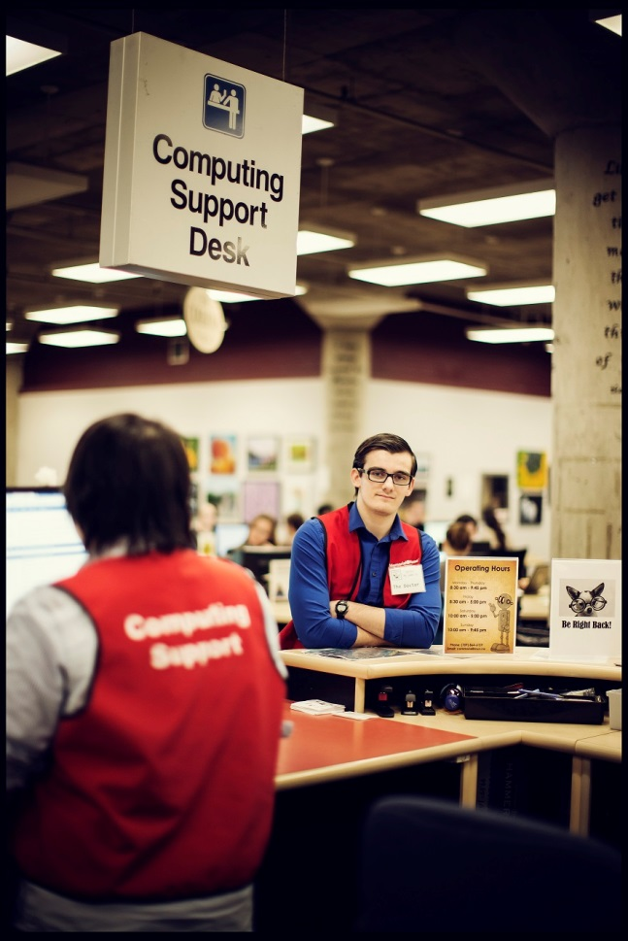
The commons sections:
Computing Support Desk
DMC
Rotunda
Makerspace
Hatcher commons

Slide 3
Types of Services:
wireless and LabNet account creation and troubleshooting
black and white printing, colour printing, and scanning
one-on-one software tutorials in Microsoft Office and Adobe Creative Suite
Brightspace (D2L) support
Assistive Technology resources, software, and tutoring services
One-on-one writing tutorials with Writing Centre tutors
Academic tutoring in The Tutorium

Slide 4
Computing Support Desk
Printing support
Photocopying
Labnet assistance
my.mun assistance
Campus card assistance (money related)
Self service assistance
D2L support
Writing centre

Slide 5
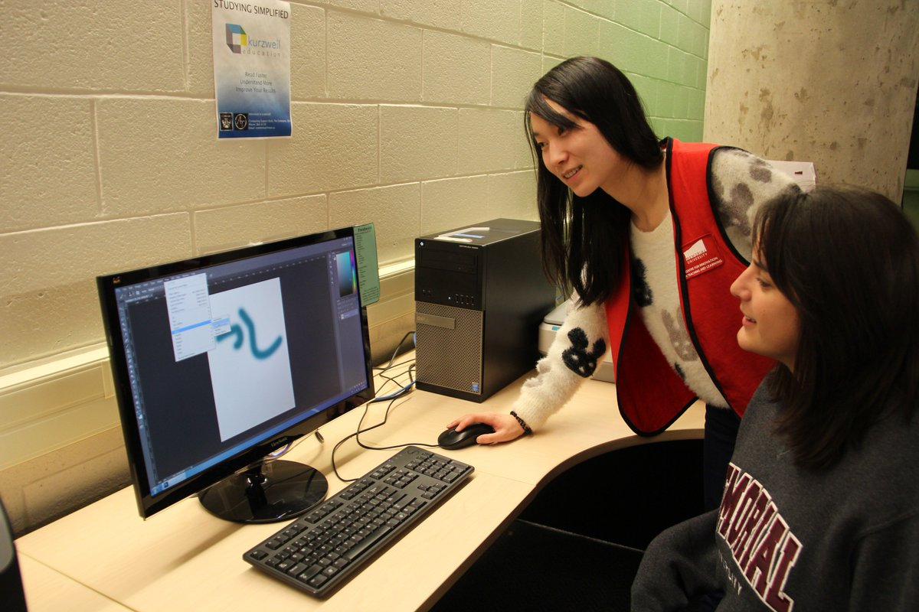
DMC (Digital Media Centre)
Adobe creative cloud suite
Scanning
Color printing
Green screen
Video editing
Plotter printing

Slide 6
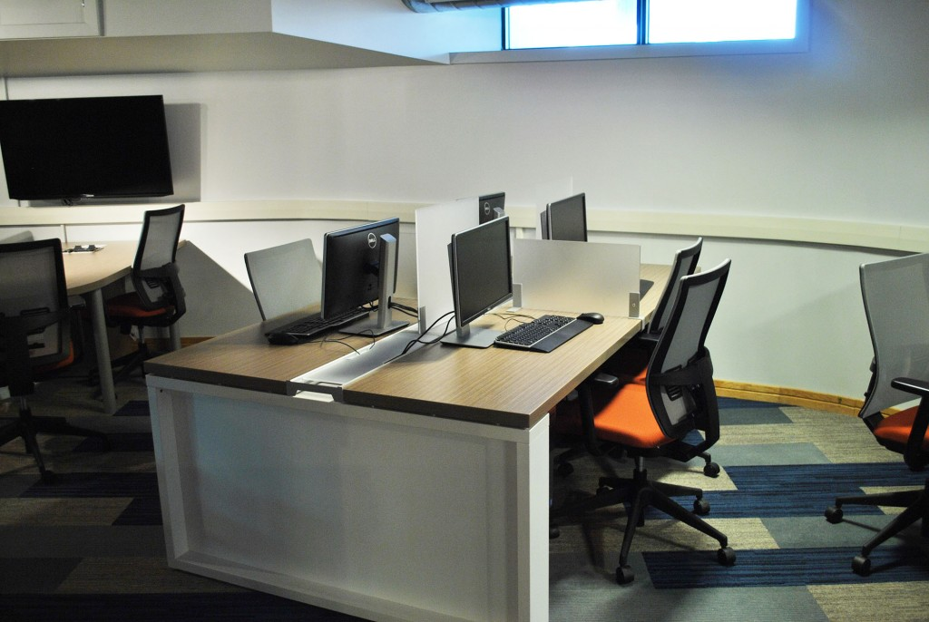
Rotunda Commons
Located under the clock tower, between the QEII Library and the University Centre. It is a division of The Commons designed specifically as a collaborative student workspace.
wireless and LabNet account creation and troubleshooting
black and white printing
software support (including MS Office and Brightspace/D2L)
general inquires

Slide 7
Hatcher Commons
The Hatcher Commons is located in the Hatcher House residence.
It is open from 2pm to 2am daily.
There are LabNet computers, black and white printing, and computer support staff to assist with technical issues.
The space also offers collaborative seating and easy access to power, and is located just across the hall from the Jumping Bean cafe.

Slide 8
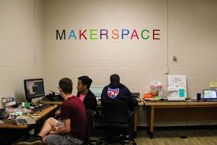
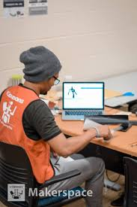
Makerspace
A makerspace is a place where people can gather to create, invent, tinker, explore and discover using a variety of tools and materials.
https://www.youtube.com/watch?v=ueaIDoBbNyM

Slide 9
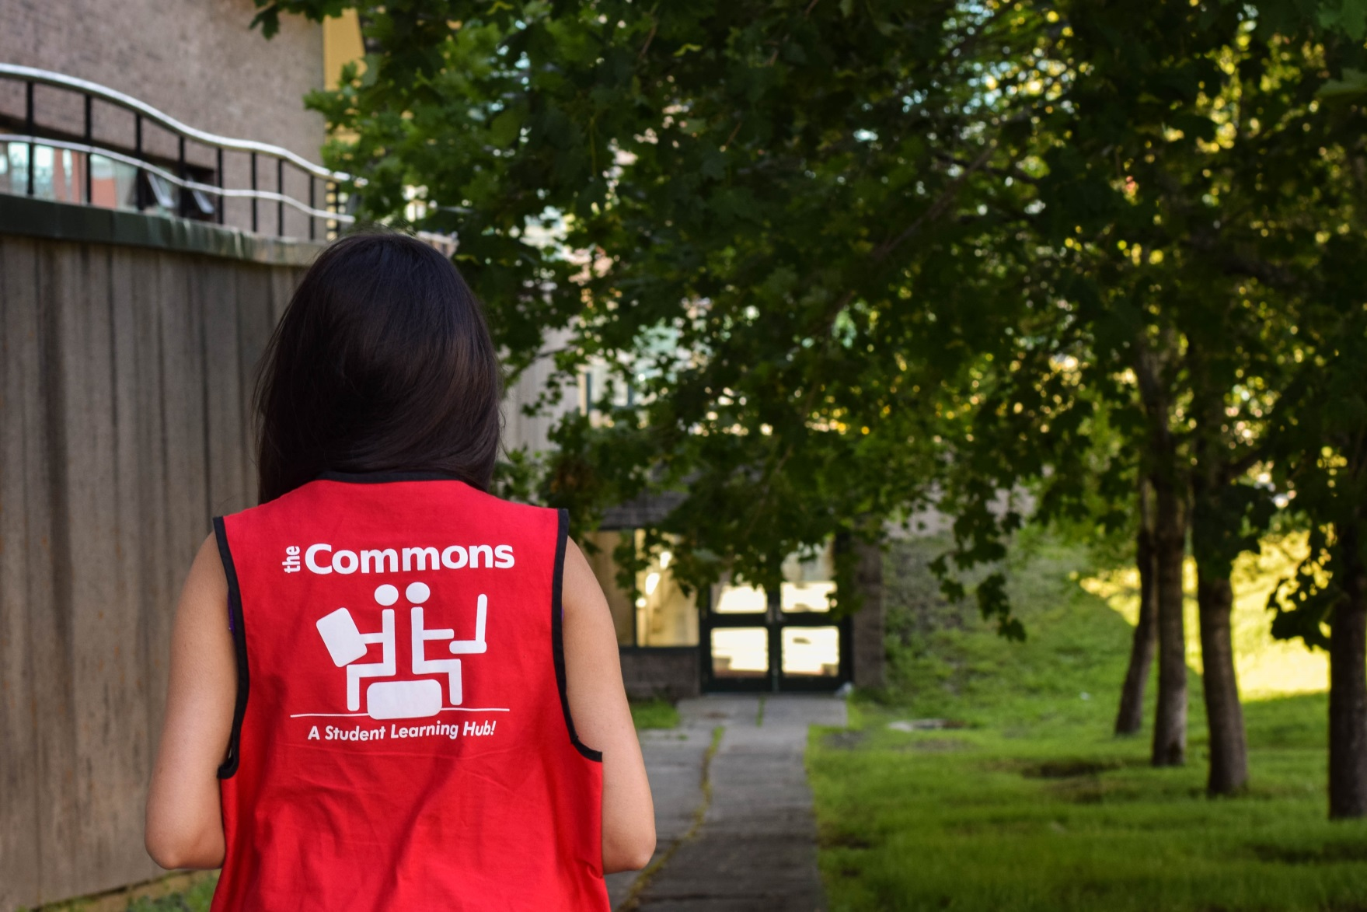
Thank you!

